Slide 1
Introduction of Recommandation System

Slide 2
What's recommandation system?

Slide 3










Who needs recommandation system?
Movie recommendation (Netflix)
Related product recommendation (Amazon)
Web page ranking (Google)
Social recommendation (Facebook)
News content recommendation (Yahoo)
Online dating (OK Cupid)
Computational Advertising (Yahoo)

Slide 4
How to recommand?

Slide 5
Recommendation System
Candidate Generation
Subset of all contents
Scoring
Scoring contents with model
Re-ranking
Make recommendation

Slide 6
Traditional Methods
熱門程度？
內容種類？
隨機推薦？
評價最好？

Slide 7
Types of recommandation system
Content-based method
Collaborative filtering method
基於內容來進行推薦
分類
大綱
作者
...
基於行為來進行推薦
觀影紀錄
過去評價
你的朋友的觀看紀錄
...

Slide 8
Content Based Filtering

Slide 9


What is content based method?
推薦和你過去喜歡的內容相似的東西
舉例來說：
如果你喜歡鋼鐵人，那系統應該要推薦美國隊長給你

Slide 10
How to do Content-based Recommendation?
根據內容的描述來決定是否相似
利用 TF-IDF 方法轉換內容
使用比較相似度的方法來辨認
Cosine Similarity
Euclidean Distance
Peason’s Correlation
Other Machine Learning Methods
建立 User & Item Profile
根據內容的特徵以及使用者的使用歷史
相似性的比較

Slide 11
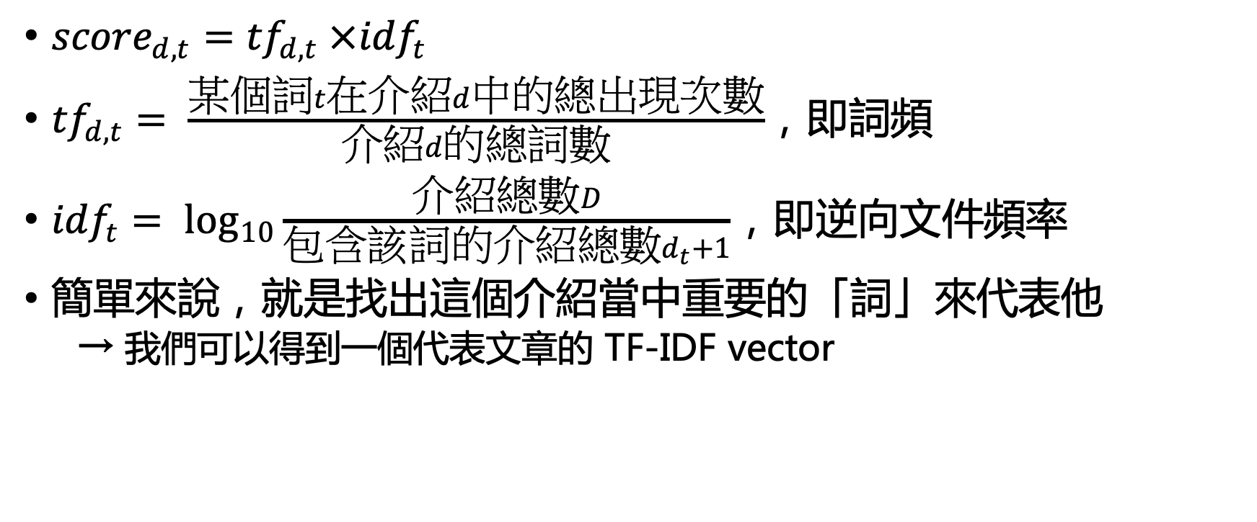
Based on summary of movies(TF-IDF)
${score}_{d,t}={tf}_{d,t} ×{idf}_{t}$
${tf}_{d,t}= \frac{某個詞t在介紹d中的總出現次數}{介紹d的總詞數}$，即詞頻
${idf}_{t}= \log_{10}{\frac{介紹總數D}{包含該詞的介紹總數d_{t}+1}}$，即逆向文件頻率
簡單來說，就是找出這個介紹當中重要的「詞」來代表他
→ 我們可以得到一個代表文章的 TF-IDF vector

Slide 12


Based on summary of movies (Similarity)
Cosine Similarity
經常用於分析文本相似程度
$Similarity=\cos{θ}=\frac{A⋅B}{\left\|A\right\|\left\|B\right\|}=\frac{\sum_{i=1}^{n}{A_{i}B_{i}}}{\sqrt{\sum_{i=1}^{n}{A_{i}^{2}}}\sqrt{\sum_{i=1}^{n}{B_{i}^{2}}}}$
B
A
$$θ$$

Slide 13
Based on summary of movies (Pros& Cons)
Pros
可以避免「New Item Problem」(No cold-start problems)
可以使用各種方法來表示一個內容
解釋性高
Cons
只會推薦相似的內容

Slide 14
Based on User/Item Profile (Construct Profile)
Construct User & Item Profile
使用者的觀看紀錄、他喜歡的影片類型或是製作人
電影本身的類型或是特徵
 | Drama | Horror | Comedy | History
Movie 1 | ✓
Movie 2 |  |  | ✓
Actor 1 | Actor 2 | Actor 3
 | ✓ | ✓
✓ |  | ✓
…
User 1 | ✓
User 2 |  |  | ✓
…
✓ | ✓
 |  | ✓

Slide 15


Based on User/Item Profile (Similarity)
Dot Product as Similarity Measure
$\left\langle x,y\right\rangle =\sum_{i=1}^{d}{x_{i}y_{i}}, with x=user, y=movie, i=property i$
利用內積計算使用者偏好和電影的相似程度
Why not Cosine-Similarity?
Profile Vector 長度相等
B
A
$$θ$$

Slide 16
Based on User/Item Profile(Pros& Cons)
Pros
User Independence: 不需要其他使用者資料
解釋性高
No cold start
Cons
需要較為完整的內容資訊
很難推薦新使用者內容

Slide 17
Collaborative Filtering

Slide 18
What is Collaborative Filtering?
Matrix of user& content(Query)
Feedbacks of contents
Explicit: Numeric Rating
Implicit: User’s Behavior
Types of collaborative filtering
Model based (Predict)
User record
Turn into optimization problem (minimize RMSE)
Memory based (Similarity)
User-based
Item-based
 | Movie1 | Movie2 | Movie3 | Movie4
User 1 | ✓ |  | ✓ | ✓
User 2 | ✓ |  | ✓
User 3 |  | ✓ |  | ✓

Slide 19


Collaborative Filtering? (Memory Based)
User-based Filtering
Item-based Filtering
用和你觀影喜好相似的人看過的內容推薦
Calculating similarity by row
依照電影被讀者喜歡的相似程度來推薦你
Calculating similarity by column

Slide 20
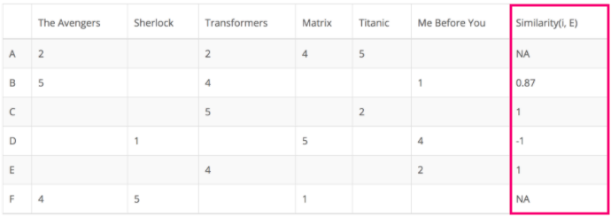
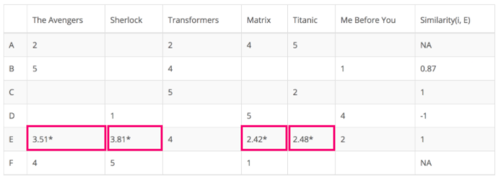
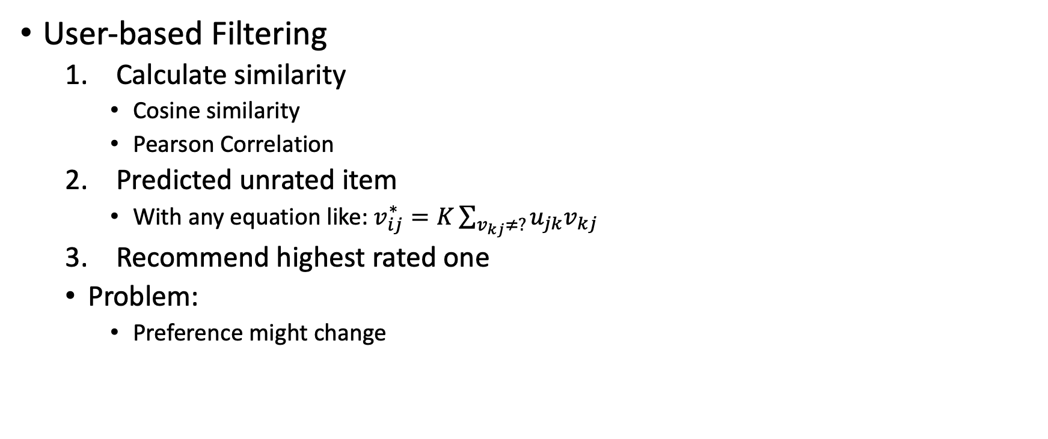
How to do Collaborative Filtering? (Memory Based)
User-based Filtering
Calculate similarity
Cosine similarity
Pearson Correlation
Predicted unrated item
With any equation like: $v_{ij}^{∗}=K\sum_{v_{kj}≠?}{u_{jk}v_{kj}}$
Recommend highest rated one
Problem:
Preference might change

Slide 21
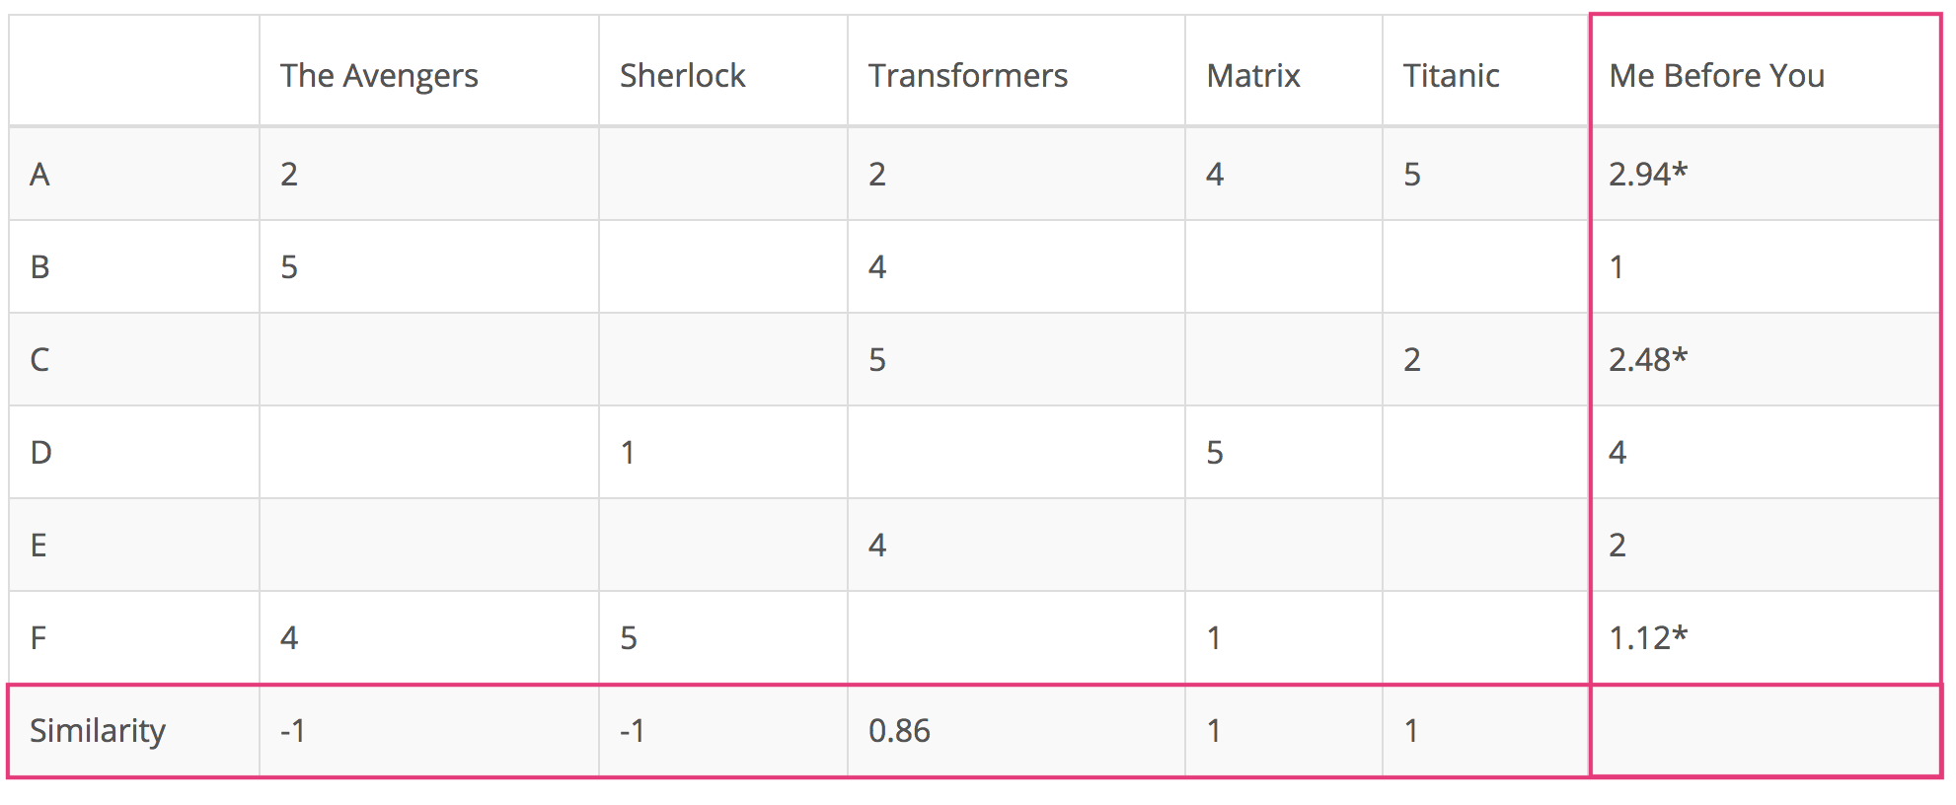
How to do Collaborative Filtering? (Memory Based)
Item-based Filtering
Calculate similarity
Predicted unrated item
Recommend highest rated one
The method is basically same as user-based CF, without dynamic user preference problem
Problems:
Scalability
Sparsity

Slide 22
What is Model-based CF?
Target:
Fill in blank with model
Turn it into optimization problem
Models:
Matrix Factorization
Neural Network
Other models
 | Movie1 | Movie2 | Movie3 | Movie4
User 1 | ✓ |  | ✓ | ✓
User 2 | ✓ |  | ✓
User 3 |  | ✓ |  | ✓

Slide 23
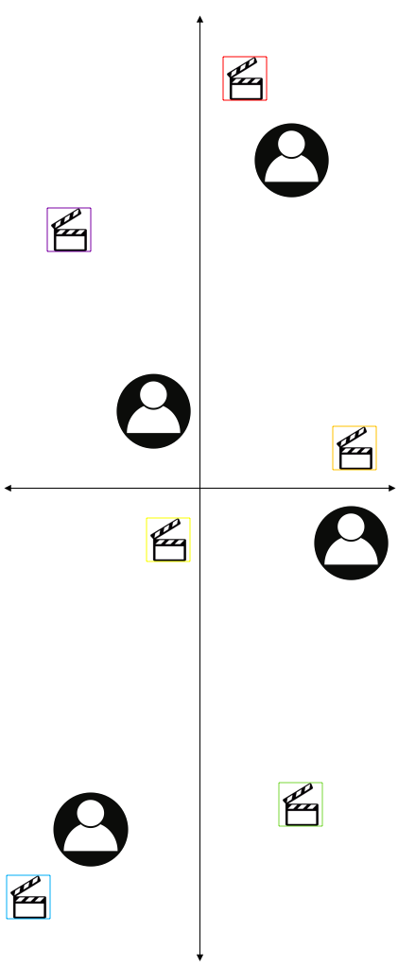
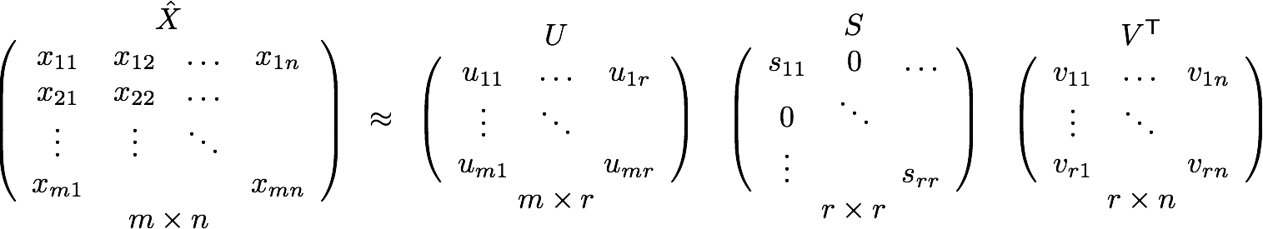

How to do Model-based Collaborative Filtering?
Latent factor model (Matrix Factorization):
SVD(Singular Value Decomposition)
$U$: relationship between user & latent factors
$V$: relationship between item & latent factors
$S$ denoted strength of latent factors
In order to minimize reconstruction error
Thus can be use to estimated RMSE

Slide 24
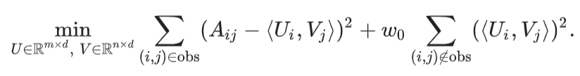

How to do Model-based Collaborative Filtering?
SVD is not ideal when matrix $X$ is sparse
Other Latent factor model (embedding):
Observed Only Matrix Factorization
Weighted Matrix Factorization(can solve sparsity)

Slide 25
Collaborative Filtering(Pros& Cons)
Pros
No domain knowledge necessary
Serendipity
No need for extra information
Cons
Cold-start problem
Hard to include side features for query/item
Low explain ability

Slide 26
Azure Personalizer
Azure Cognitive Service

Slide 27
What's Azure Personalizer?
Cloud-based API service for recommending
Trained with reinforcement learning
Rank API v.s. Reward API

Slide 28

What's reinforcement learning?
Machine "observe" input, interact with "environment"
Elements
Agent (bird)
Environment (game setting)
Observation (location of bird)
Action (to fly or to fall)
Reward (score)

Slide 29
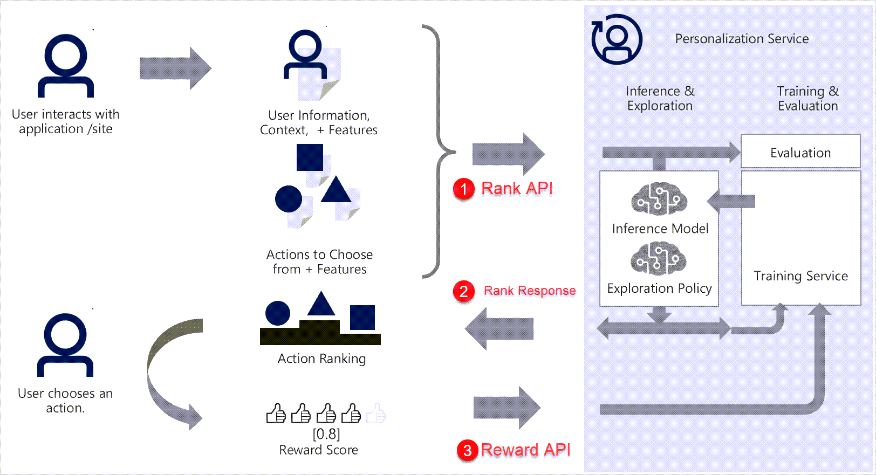
Azure Personalizer
Rank API
Call with
Actions with features
Context features
Return
Action
Reward API
Call with
Reward Score (Fit your condition)
Retrain Model
Real-time or delay (Offline?)
Apprentice mode

Slide 30
Try Your Personalizer
Github repo: https://github.com/Azure-Samples/cognitive-services-personalizer-samples

